Slide 1
Algorithms: Greedy Algorithms
Computer Science, Purdue University
Copyright WILEY, Goodrich and Tamassia, Data Structures And Algorithms

Slide 2
Algorithms: Greedy Algorithms
Greedy Algorithms
Make the locally optimal (best) choice at each step
A sequence of these locally optimal choices lead to a globally optimal choice for many algorithms.
We had seen examples of such algorithms in making change with minimum number of coins in an earlier segment
In this segment, we will learn about greedy algorithms on graphs for computing shortest paths and minimum spanning trees
Computer Science, Purdue University

Slide 3
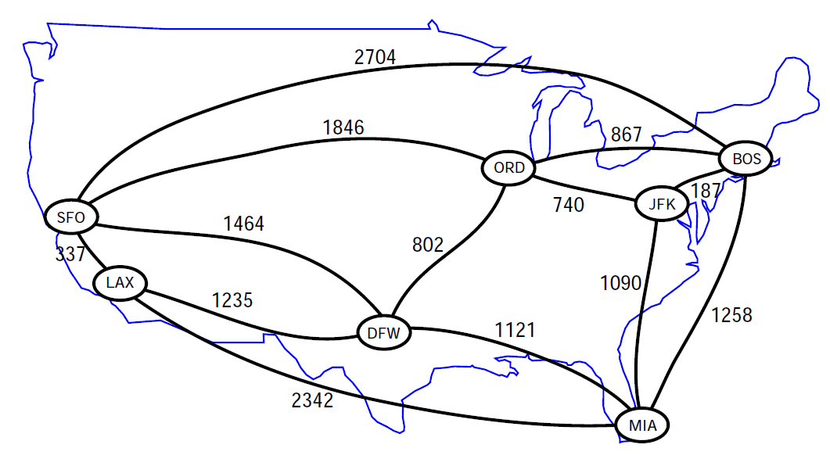
Algorithms: Greedy Algorithms
Shortest Paths in Graphs
Computer Science, Purdue University

Slide 4
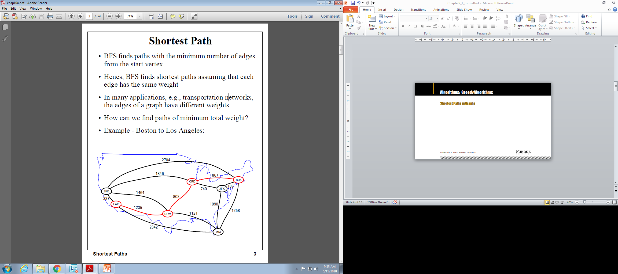
Algorithms: Greedy Algorithms
Shortest Paths in Graphs
Computer Science, Purdue University

Slide 5
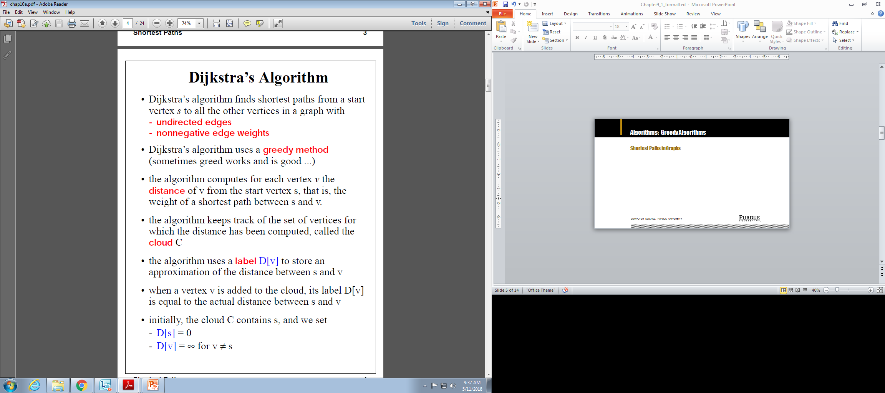
Algorithms: Greedy Algorithms
Shortest Paths in Graphs
Computer Science, Purdue University

Slide 6
Algorithms: Greedy Algorithms
Shortest Paths in Graphs: Dijkstra’s Algorithm
Computer Science, Purdue University

Slide 7
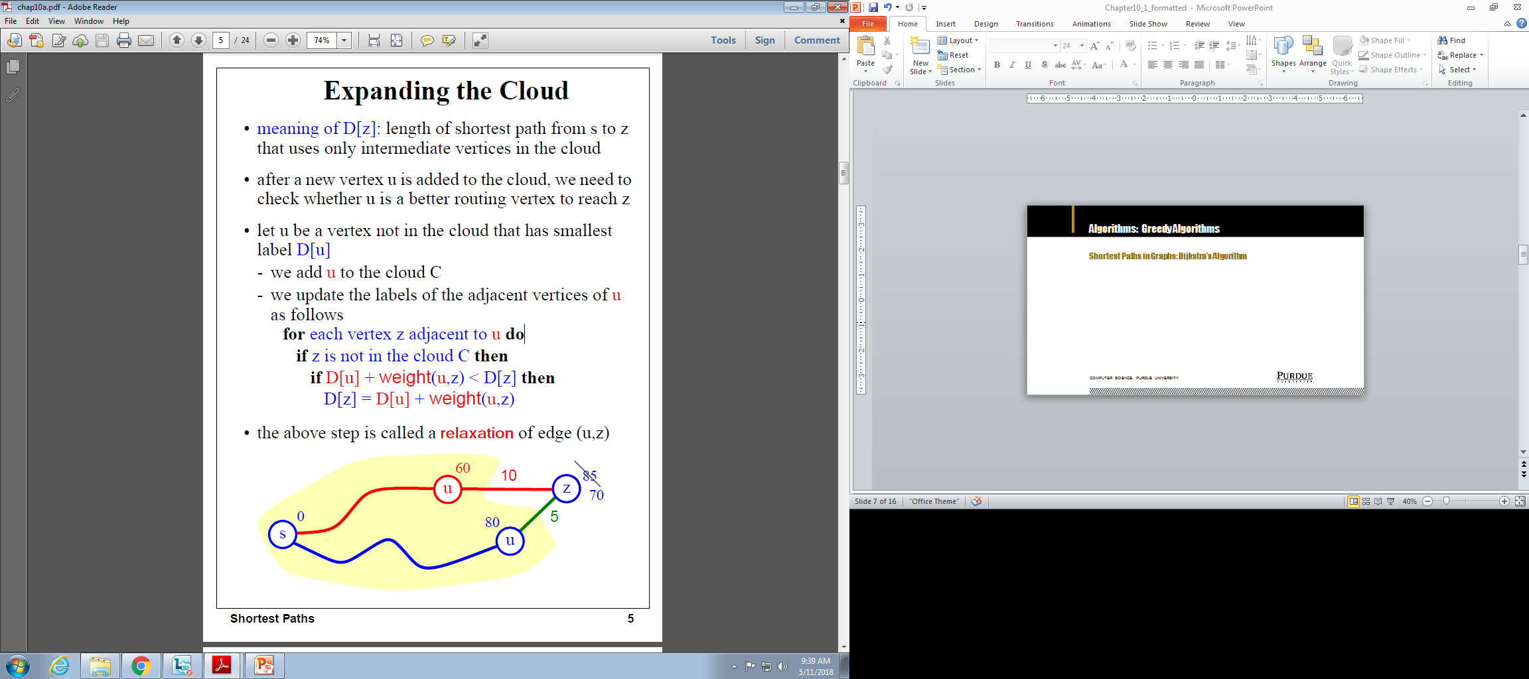
Algorithms: Greedy Algorithms
Shortest Paths in Graphs: Dijkstra’s Algorithm
Computer Science, Purdue University

Slide 8
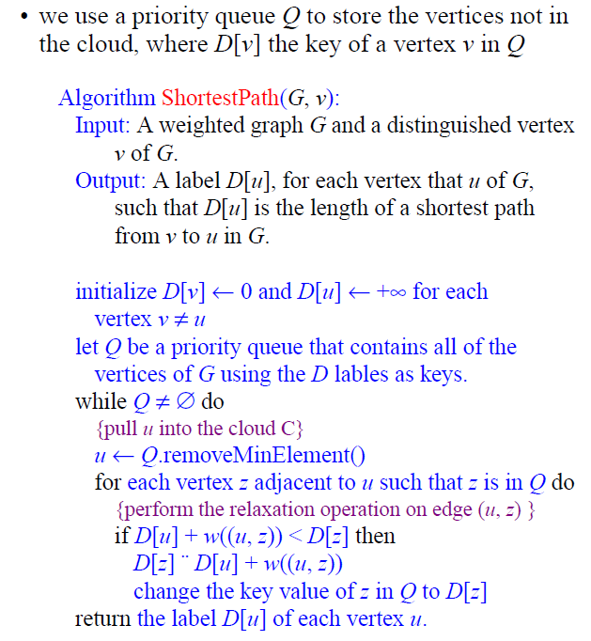
Algorithms: Greedy Algorithms
Shortest Paths in Graphs:
Dijkstra’s Algorithm
Computer Science, Purdue University

Slide 9
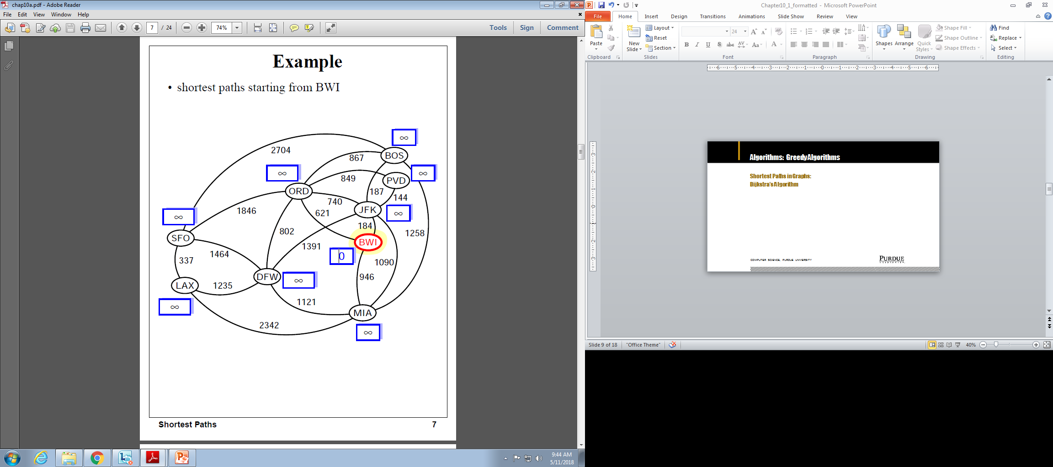
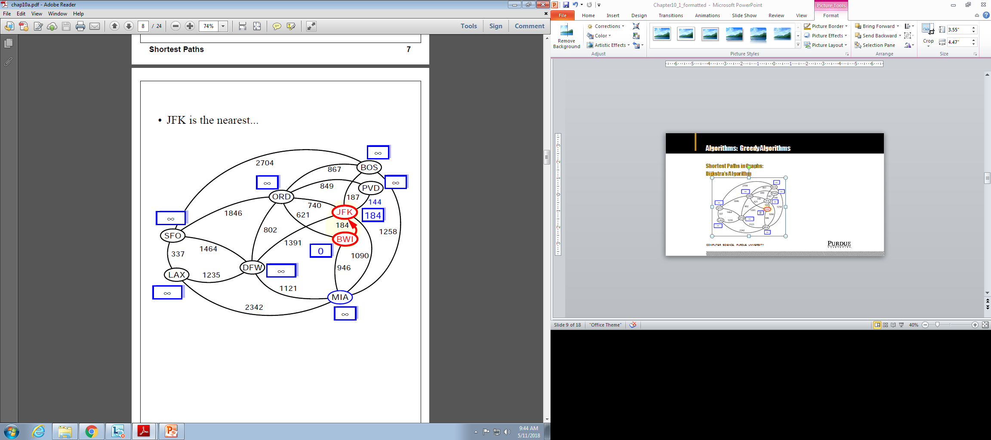
Algorithms: Greedy Algorithms
Shortest Paths in Graphs:
Dijkstra’s Algorithm
Computer Science, Purdue University

Slide 10
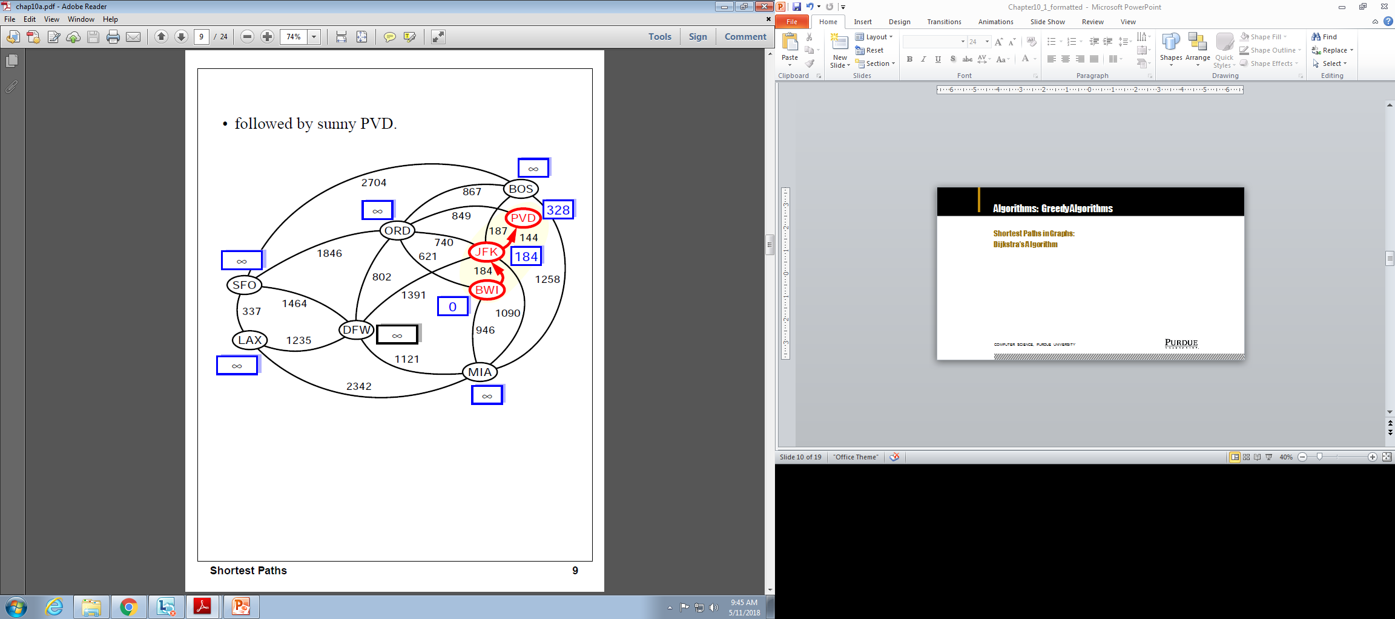
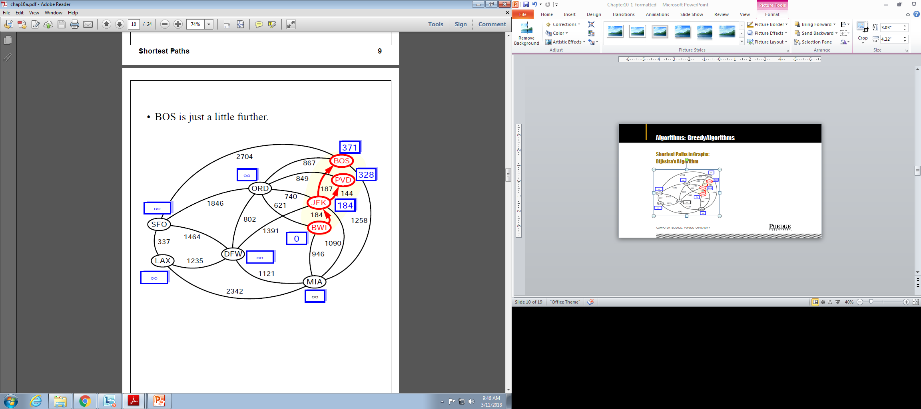
Algorithms: Greedy Algorithms
Shortest Paths in Graphs:
Dijkstra’s Algorithm
Computer Science, Purdue University

Slide 11
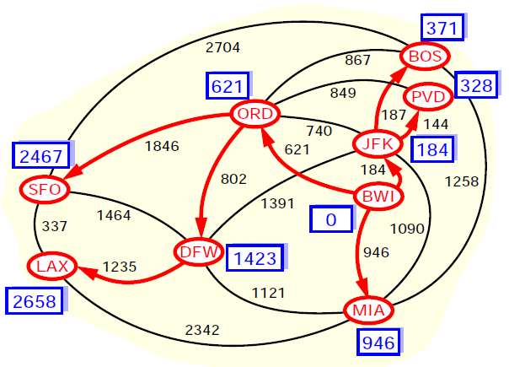
Algorithms: Greedy Algorithms
Shortest Paths in Graphs:
Dijkstra’s Algorithm
Computer Science, Purdue University

Slide 12
Algorithms: Greedy Algorithms
Shortest Paths in Graphs:
Dijkstra’s Algorithm
Computer Science, Purdue University

Slide 13
Algorithms: Greedy Algorithms
Shortest Paths in Graphs: Dijkstra’s Algorithm
Running Time
Let’s assume that we represent G with an adjacency list. We can then step through all the vertices adjacent to u in time proportional to their number (i.e. O(j) where j in the number of vertices adjacent to u)
The priority queue Q:
A Heap: Implementing Q with a heap allows for efficient extraction of vertices with the smallest D label(O(log N)). If Q is implemented with locators, key updates can be performed in O(log N) time. The total run time is O((n+m)log n) where n is the number of vertices in G and m in the number of edges. In terms of n, worst case time is O(n²log n)
Unsorted Sequence: O(n) when we extract minimum elements, but fast key updates (O(1)). There are only n-1 extractions and m relaxations. The running time is O(n²+m)
Computer Science, Purdue University

Slide 14
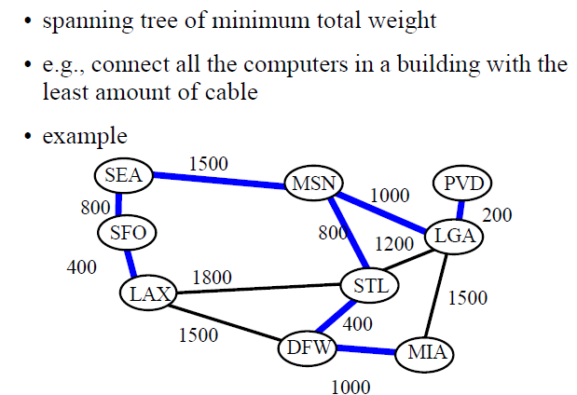
Algorithms: Greedy Algorithms
Minimum Spanning Tree
Computer Science, Purdue University

Slide 15
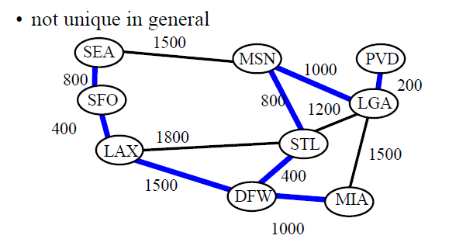
Algorithms: Greedy Algorithms
Minimum Spanning Tree
Computer Science, Purdue University

Slide 16
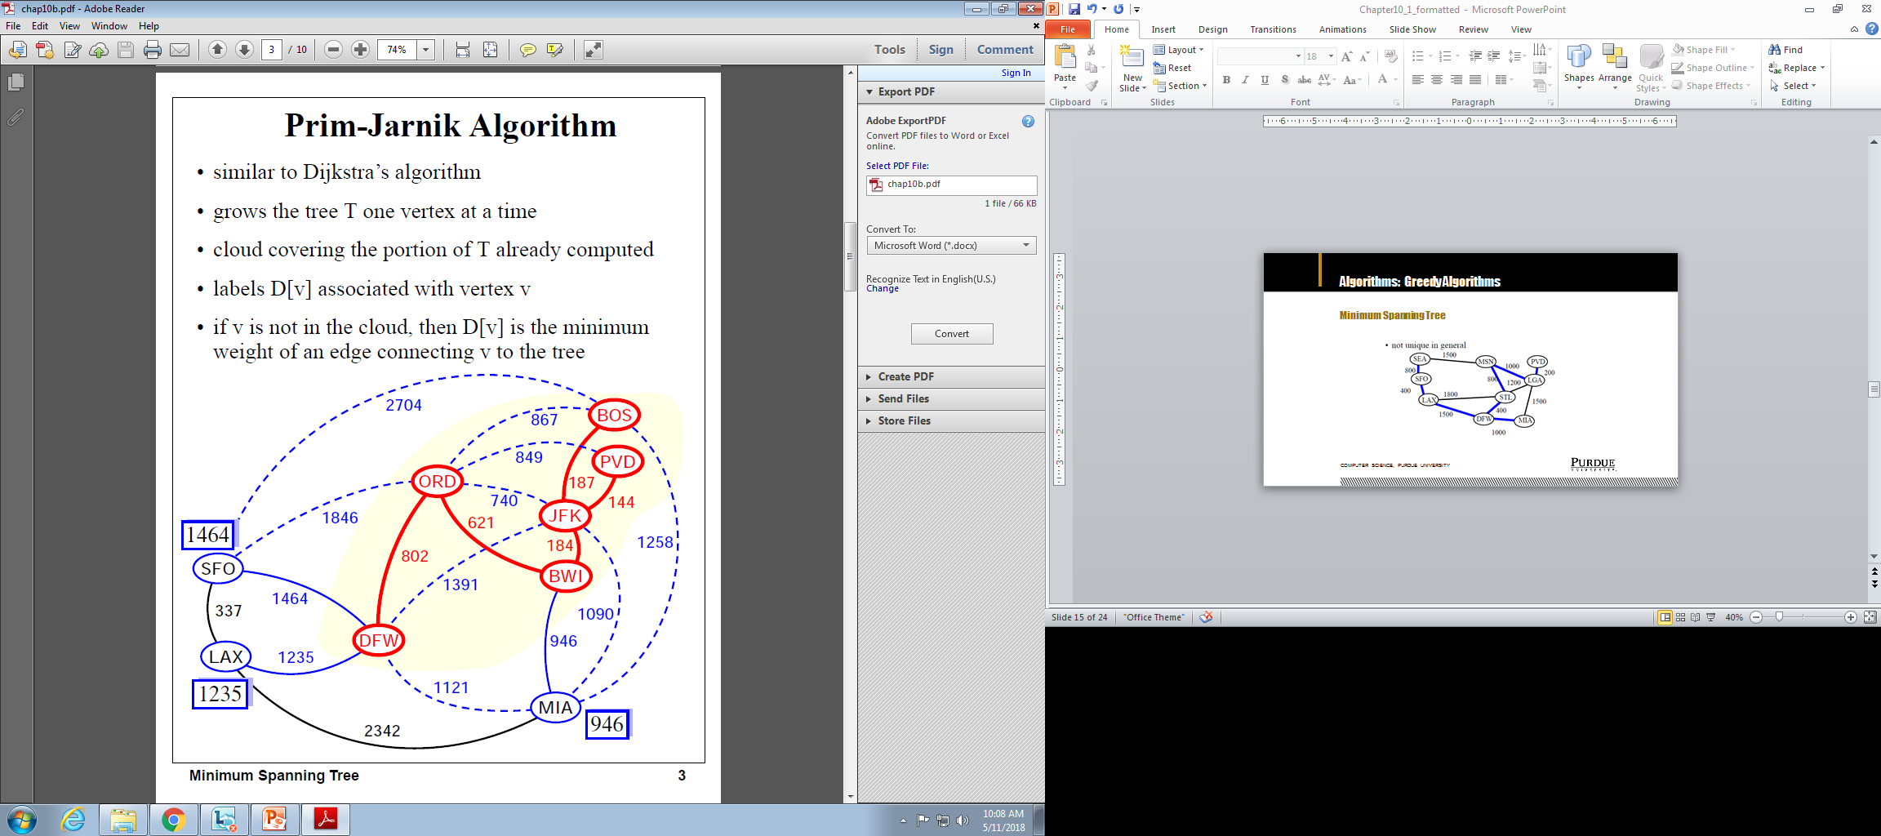
Algorithms: Greedy Algorithms
Minimum Spanning Tree
Computer Science, Purdue University

Slide 17

Algorithms: Greedy Algorithms
Minimum Spanning Tree:
Prim-Jarnik Algorithm
Runtime is same as the shortest path algorithms
Computer Science, Purdue University

Slide 18
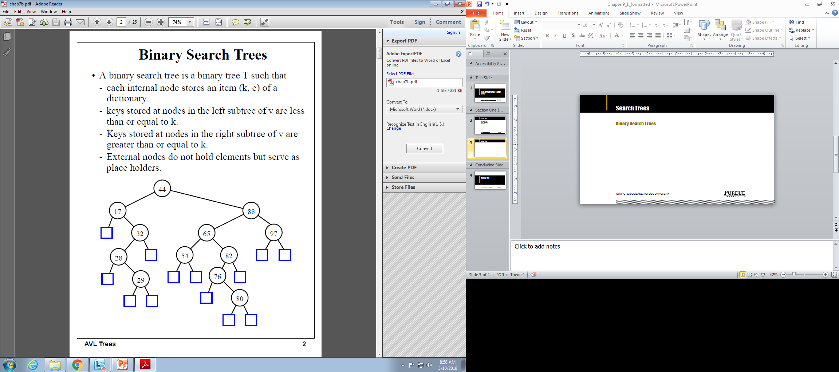
Search Trees
Binary Search Trees
Computer Science, Purdue University

Slide 19
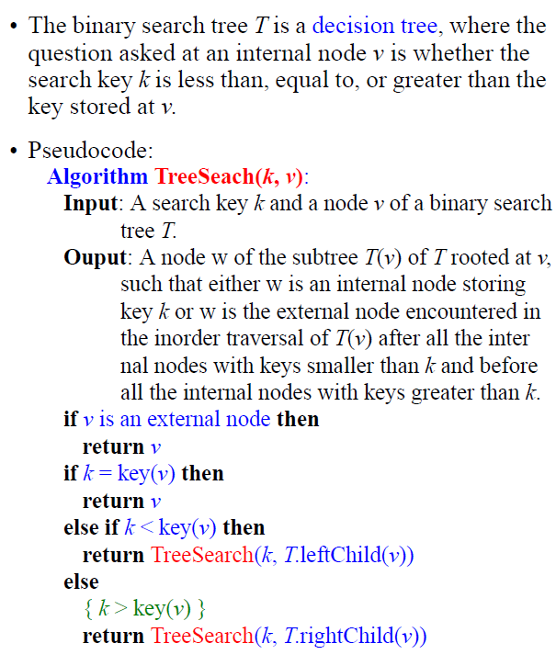
Search Trees
Binary Search Trees
Computer Science, Purdue University

Slide 20
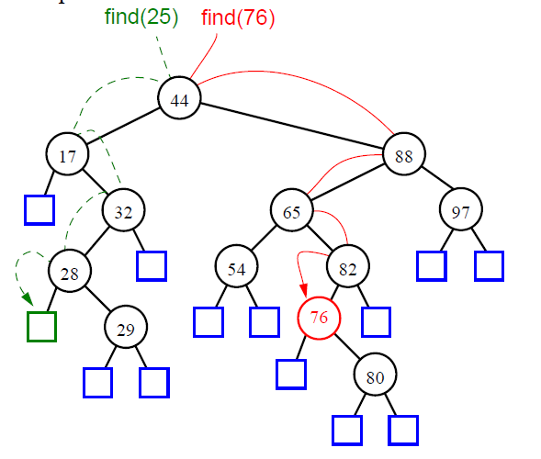
Search Trees
Binary Search Trees
Computer Science, Purdue University

Slide 21
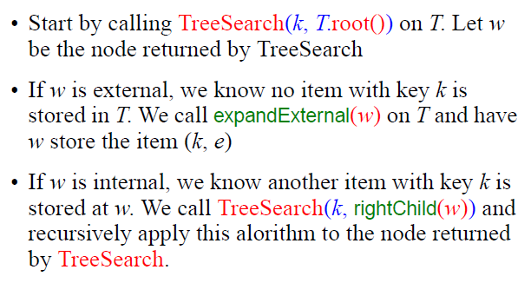
Search Trees
Binary Search Trees:
Insertion
Computer Science, Purdue University

Slide 22
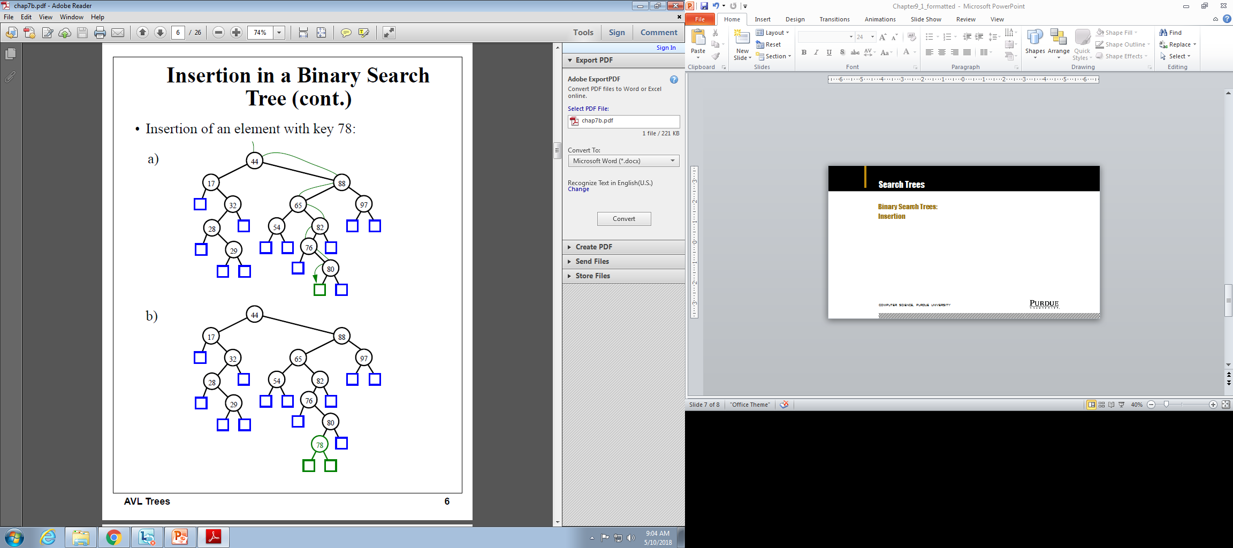
Search Trees
Binary Search Trees:
Insertion
Computer Science, Purdue University

Slide 23
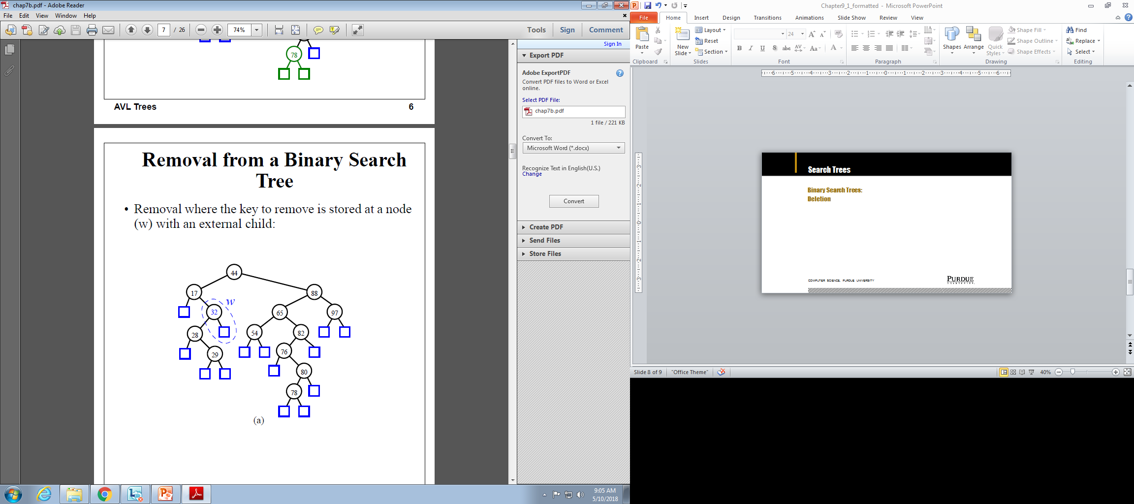
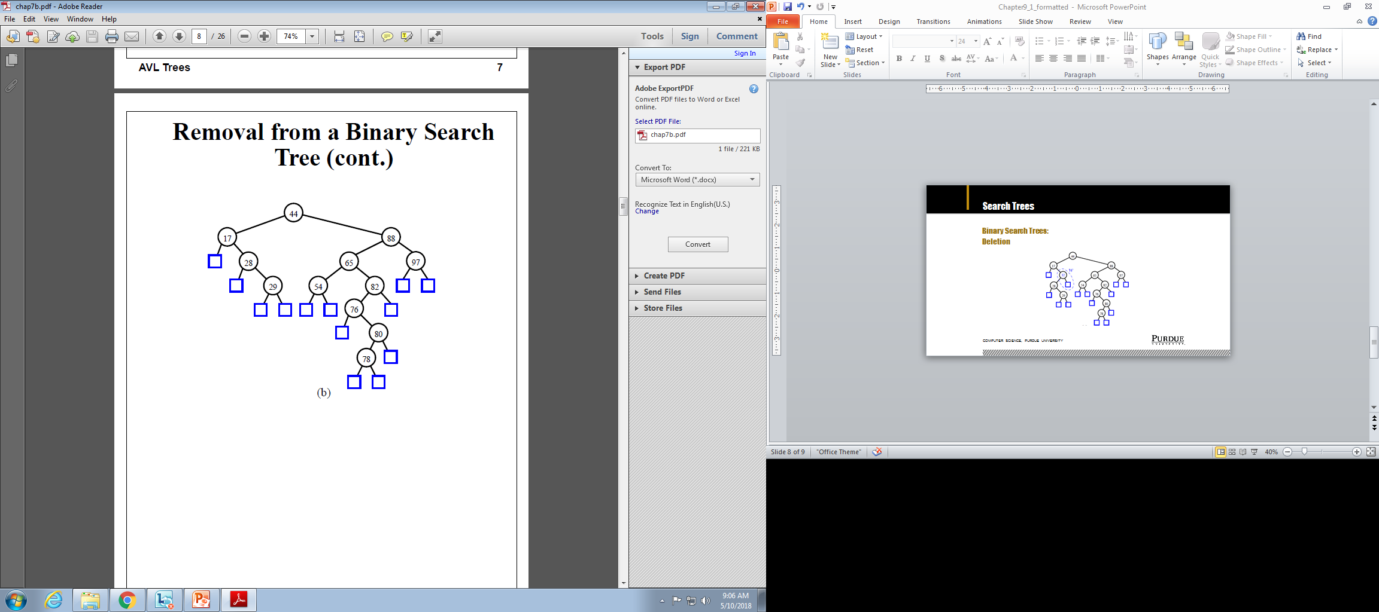
Search Trees
Binary Search Trees:
Deletion
Computer Science, Purdue University

Slide 24
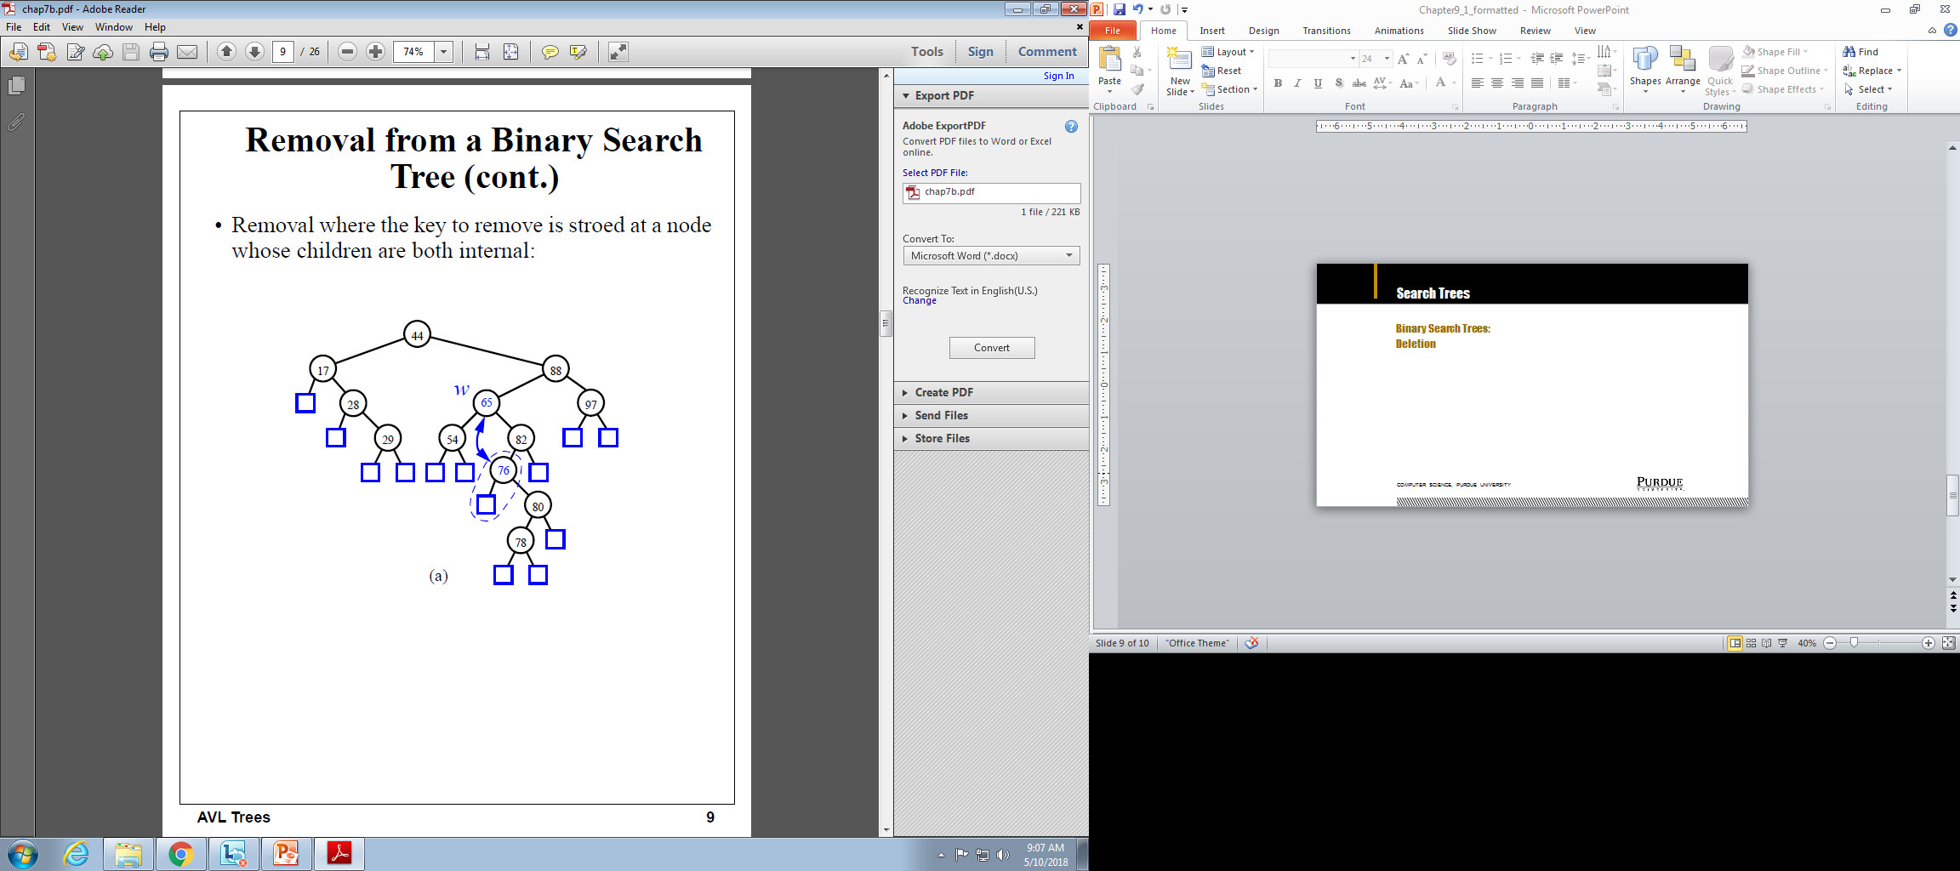
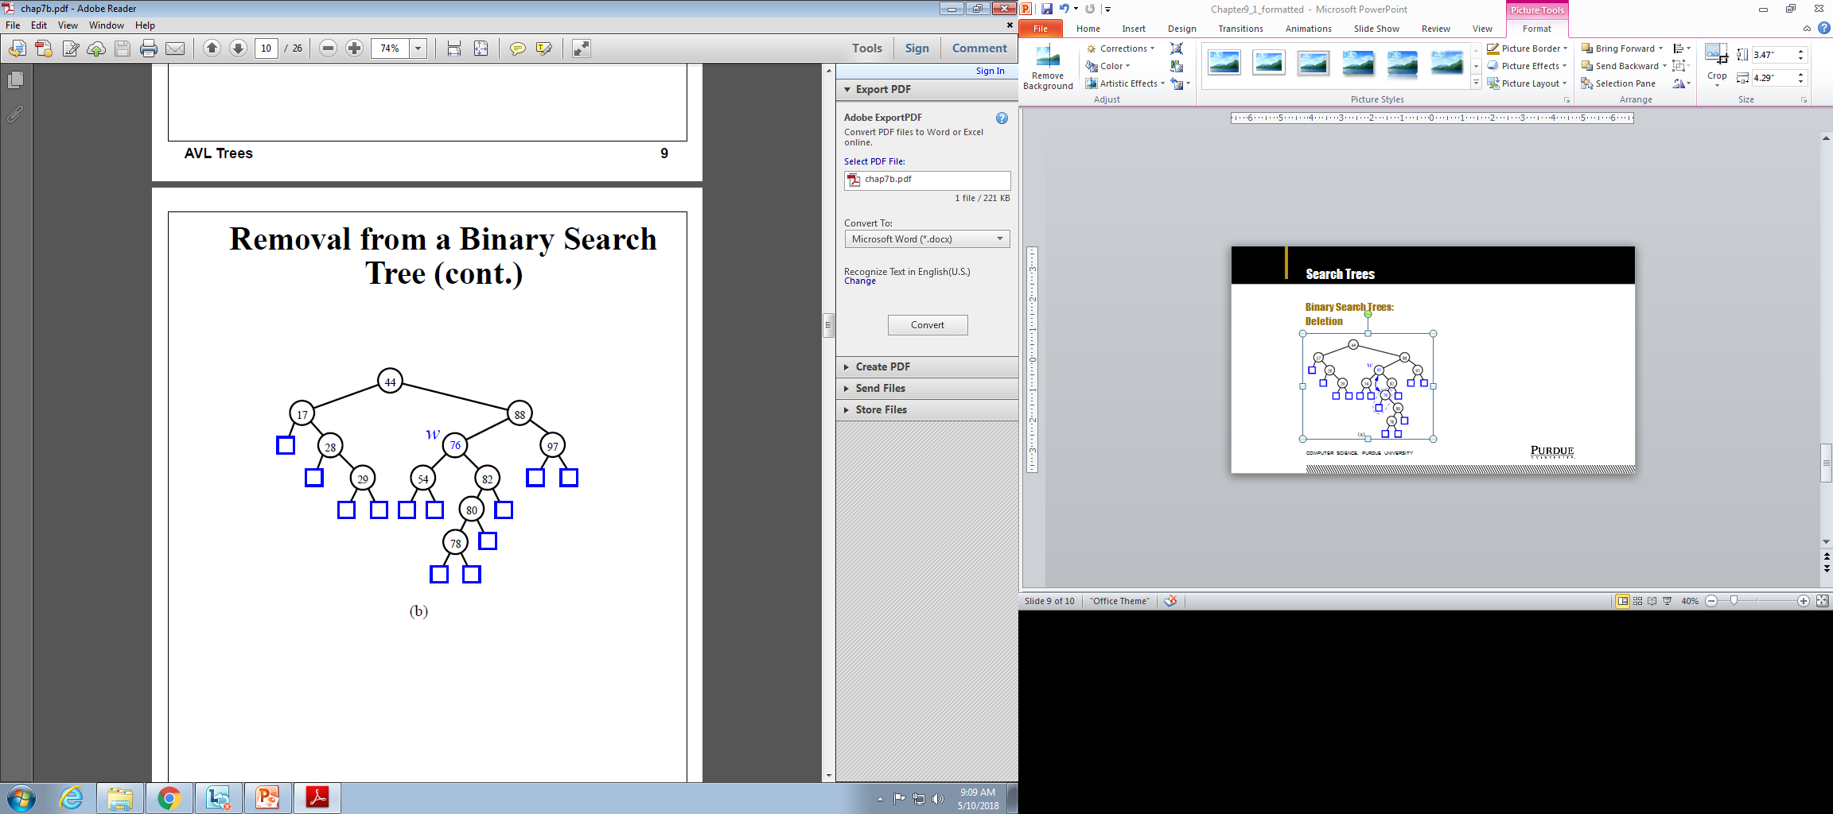
Search Trees
Binary Search Trees:
Deletion
Computer Science, Purdue University

Slide 25

Search Trees
Binary Search Trees: Time Complexity
Computer Science, Purdue University

Slide 26
Thank You

